Slide 1



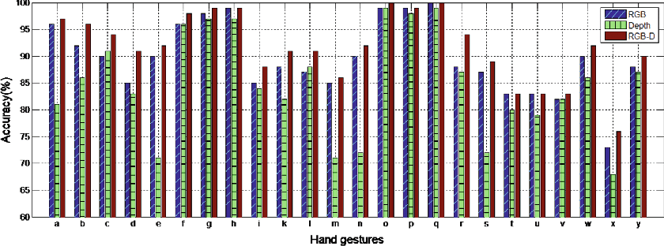
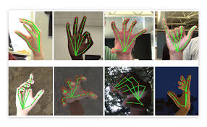


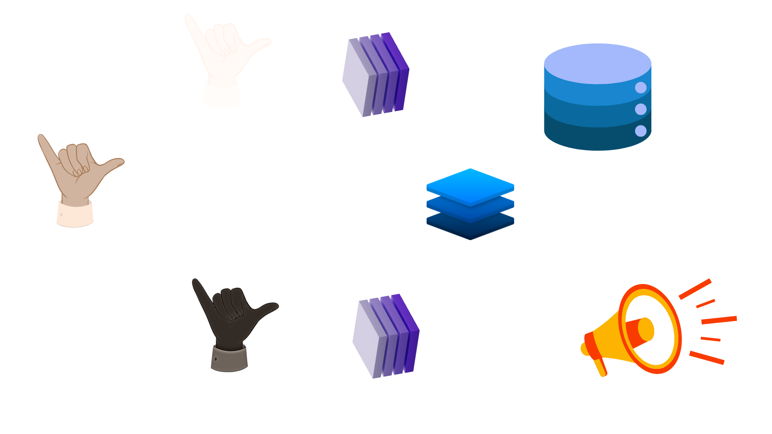
.
SignScript: Advanced Translation System for Converting Sign Language and Text
Department of Computer Science & Engineering
School of Computing
Smart India Hackathon - 2024
PS No. : 1716
PS Organization: Ministry of Social Justice
and Empowerment
ABSTRACT
Solution Proposal
RESULTS
Technology Stack
Indian Sign language is a vital means of communication for the deaf and hard of hearing community, but it can be a barrier for those who do not know sign language. Automatic sign language recognition systems have the potential to bridge this communication gap. This system uses computer vision and machine learning
techniques to recognize and interpret sign language. The system is trained on a large dataset of sign language videos and achieves high accuracy in recognizing individual signs and phrases. Additionally, the system can be integrated with speech recognition systems to enable communication between sign language users and non-sign language users.
Sign language recognition is a crucial solution to overcome the communication barriers faced by deaf and dumb people. The primary goal of sign language recognition systems is to enable deaf and dumb individuals to communicate with the rest of the world using sign language. This can be achieved by the website that we have created which helps lot of sign language users to convey their views. It is an user interactive platform for recognizing sign language and translate it into text or speech in real-time. Our system utilize deep learning techniques like Convolutional Neural Networks (CNNs) and Recurrent Neural Networks (RNNs) to recognize and classify sign language gestures. Using a dataset of annotated sign language videos, our model is trained to identify and classify hand shapes, orientations, and movements, allowing for real-time translation into text or speech. Our solution overcomes existing limitations in sign language recognition, including variability in signing styles and lighting conditions. With an accuracy rate of 80%, our system has the potential to revolutionize communication for the deaf and hard of hearing community, promoting social inclusion and accessibility in various aspects of life, from education and employment to healthcare and social interactions.
.
The sign language recognition system has been designed to effectively convert sign language gestures into text and vice versa, with several key outcomes anticipated upon its implementation. The system is expected to achieve high accuracy in recognizing a broad range of sign language gestures, with a target accuracy rate of approximately 90%. It should be able to accurately interpret common signs and phrases from the sign language dataset, enabling seamless translation between sign language and text. Precision and recall metrics are anticipated to be high, ensuring reliable recognition of individual signs and sequences. Furthermore, the integration of this system into web and mobile platforms is expected to enhance accessibility, providing users with an easy-to-use tool for communication. The anticipated results include robust performance across different devices and environments, supporting widespread adoption and practical use in educational and everyday contexts.
The technology stack for a sign language recognition system encompasses a diverse set of tools and frameworks designed to capture, process, and analyze sign language gestures. On the software side, programming languages like Python and JavaScript are employed for developing the core functionality and user interface. Deep learning frameworks, particularly Convolutional Neural Networks (CNNs) for spatial feature extraction and Recurrent Neural Networks (RNNs), including You Only Look Once(YOLOv8n) networks, for sequence modeling. For web-based applications, HTML5, CSS, and JavaScript are used to create an interactive interface. Data management involves SQL or NoSQL databases for storing structured and unstructured data, complemented by annotation tools like Computer Vision Annotation Tool(CVAT) for preparing training datasets. Development is supported by integrated development environments such as Kaggle(Opensource),and Ultralytics which is a machine learning Library.
TEAM MEMBER DETAILS
Marthala Bhargavi
VTU23371
9100228595
Alapati Hema Latha
VTU22344
9971869870
Yash Raj
VTU23168
7004835906
V.Chakradhar
VTU22842
9182197898
T.Jeevan Sai
VTU22514
9948972000
S.Pavaneswar Reddy
VTU21992
9121998920
Figure 2: Efficiency of the dataset
USE CASES
Process Flow of the Solution
Figure 1: Data Processing
The Dependencies and Show Stopper
Dependencies:
1. Data Collection and Annotation.
2. Training deep learning models and methods. .
3. The technology is affordable and accessible.
Show Stoppers:
1. Budget constraints.
2. Lack of stakeholder support.
3. Technological limitations..
Figure 2:Social Inclusion
Figure 3: Educational Purpose
ACKNOWLEDGEMENT
Dr.N.MALARVIZHI / Professor
TTS2250
9003183172
drnmalarvizhi@veltech.edu.in
Chart 1. Process Flow of GestureSpeak

